Slide 1

WEB TECHNOLOGIES
HTML - Basic Markups
Vinay Joshi
Department of
Computer Science and Engineering

Slide 2
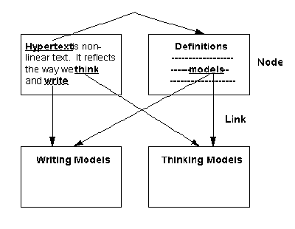
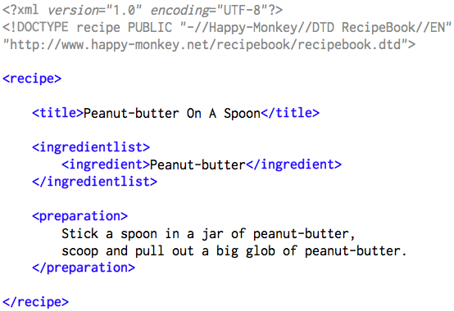
HTML – Basic Markups
Introduction
HTML– Hyper Text Markup Language
Hypertext - cross-referencing /linking between related sections of text and associated graphic material
Hyper Text-Text which contains links to other text, web pages, images, files audio, video
Markup - define elements within a document using tags

Slide 3
HTML – Basic Markups
Basic Syntax
Elements are defined by tags (markers)
Tag format:
Opening tag: <tag_name>
Closing tag: </tag_name>
Syntax:
<tag_name>
Content…
</tag_name>
Not all tags have content
If a tag has no content, its form is <tag_name … />
The container and its content together are called an element

Slide 4
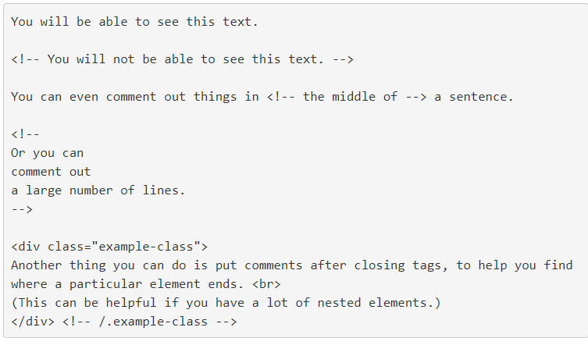
HTML – Basic Markups
Comments
An HTML comment begins with <! – – and the comment closes with – –>.
HTML comments are visible to anyone that views the page source code, but are not rendered when the HTML document is rendered by a browser.

Slide 5
HTML – Basic Markups
Document Structure
<html>
<head>
<title>… </title>
</head>
<body>
…
</body>
</html>

Slide 6
HTML – Basic Markups
Document Structure Elements
The following elements are part of every web page.
Element | Description
<html></html> | Surrounds the entire page
<head></head> | Contains header information (metadata, CSS styles, JavaScript code)
<title></title> | Holds the page title normally displayed in the title bar and used in search results
<body></body> | Contains the main body text. All parts of the page normally visible are in the body

Slide 7
Every XHTML document must begin with <html>
<html>, <head>, <title>, and <body> are required in every document
The whole document must have <html> as its root
A document consists of a head and a body
The <title> tag is used to give the document a title, which is normally displayed in the browser’s window title bar (at the top of the display)
HTML – Basic Markups
Document Structure

Slide 8
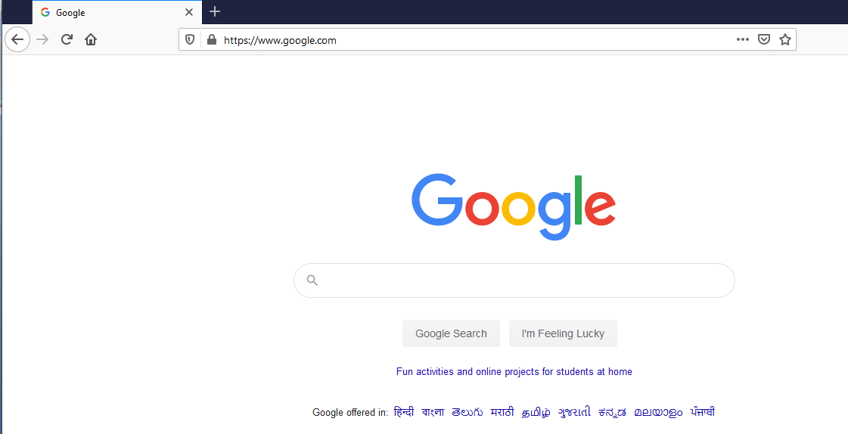
HTML – Basic Markups
Document Structure
title
body

Slide 9

HTML – Basic Markups
Common Tags / Elements
Images
Paragraph
Headings
Links

Slide 10
HTML – Basic Markups
Common Tags / Elements
Text Content
Paragraphs
Headings
Lists
Tables
Images
Links

Slide 11
HTML – Basic Markups
Paragraph
Text is normally placed in paragraph elements
Paragraph Elements:
The <p> tag breaks the current line and inserts a blank line - the new line gets the beginning of the content of the paragraph
The browser puts as many words of the paragraph’s content as will fit in each line
Example:
<p>
A paragraph always starts on a new line, and browsers automatically add some white space (a margin) before and after a paragraph.
</p>
</pre> pre formatted text

Slide 12
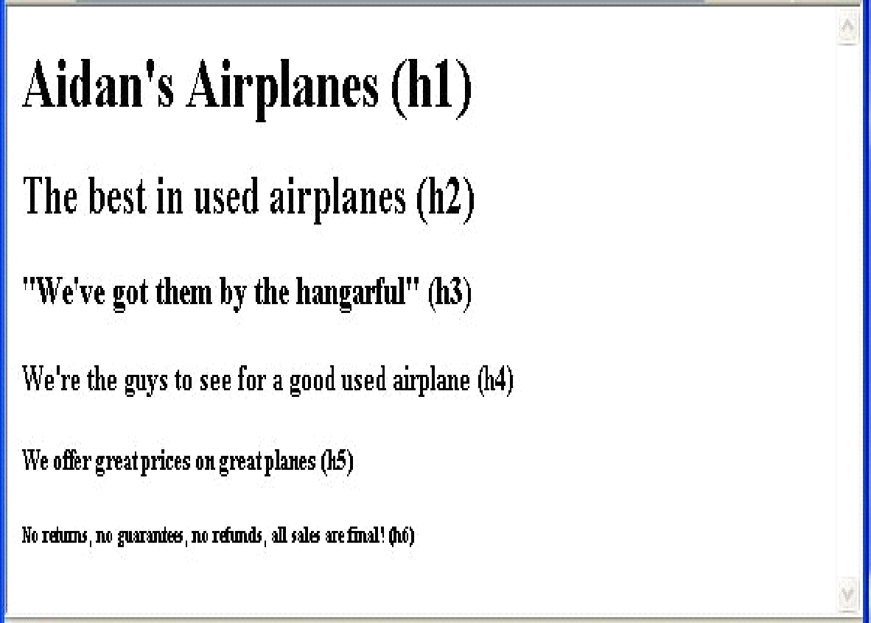
HTML – Basic Markups
Headings
Example:
<body>
<h1> Aidan’s Airplanes </h1>
<h2> The best in used airplanes </h2>
<h3> "We’ve got them by the hangarful" </h3>
<h4> We’re the guys to see for a good used airplane /h4> <!– Regular text size -->
<h5> We offer great prices on great planes </h5>
<h6> No returns, no guarantees, no refunds </h6>
</body>

Slide 13
HTML – Basic Markups
Formatting tags
Superscripts and subscripts
Subscripts with <sub>
Superscripts with <sup>
Example: x<sub>2</sub><sup>3</sup>
Display: x₂³
Inline versus block elements
Inline elements do not start on a new line and only take up as much width as necessary.
Example <span>, <img>, <a>, <strong>
Block elements always start on a new line and take up the full width available.
Example <div>, <p>, <h1> to <h6>, <li>
Block elements CANNOT be nested in inline elements

Slide 14
HTML – Basic Markups
Special Characters
Character Entities:
Char. Entity Meaning
& &amp; Ampersand
< &lt; Less than
> &gt; Greater than
” &quot; Double quote
’ &apos; Single quote
(space) &nbsp; Non-breaking space
Horizontal rules:
<hr /> draws a line across the display, after a line break

Slide 15
HTML – Basic Markups
Images
GIF (Graphic Interchange Format) =8-bit color (256 different colors)
JPEG (Joint Photographic Experts Group) =24-bit color (16 million different colors)
Portable Network Graphics (PNG)
Images are inserted into a document with the <img /> tag with the src attribute
The alt attribute is required by XHTML
<img src = "comets.jpg" alt = "Picture of comets" />
The <img> tag has 30 different attributes, including width and height (in pixels)

Slide 16
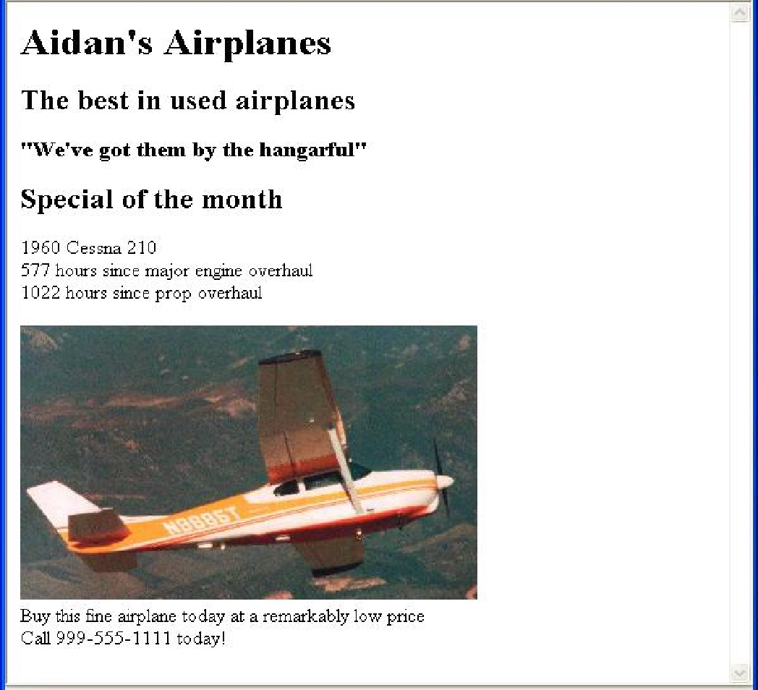
HTML – Basic Markups
Images…(cntd.)
<html>
<head> <title> Images </title>
</head>
<body>
<p>
<img src = "c210new.jpg" alt = "Picture of a Cessna 210"/>
<br />
Buy this fine airplane today at a
remarkably low price <br />
Call 999-555-1111 today!
</p>
</body>
</html>

Slide 17
HTML – Basic Markups
Hypertext Links
Hypertext is the essence of the Web!
A link is specified with the href attribute of <a> (the anchor tag)
The content of <a> is the visual link in the document
If the target is a whole document (not the one in which the link appears), the target need not be specified in the target document as being the target
Note: Relative addressing of targets is easier to maintain and more portable than absolute addressing

Slide 18
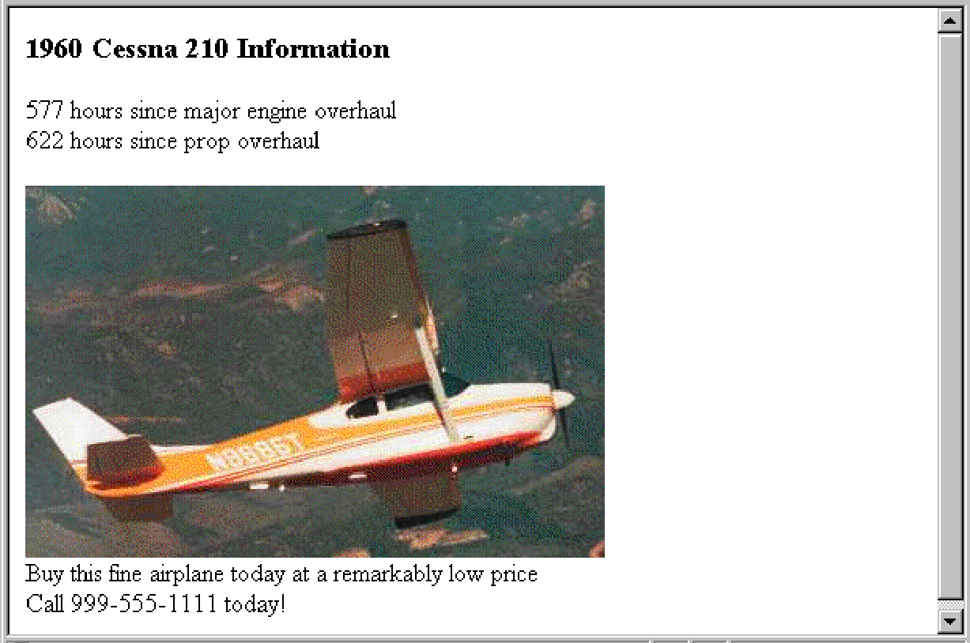
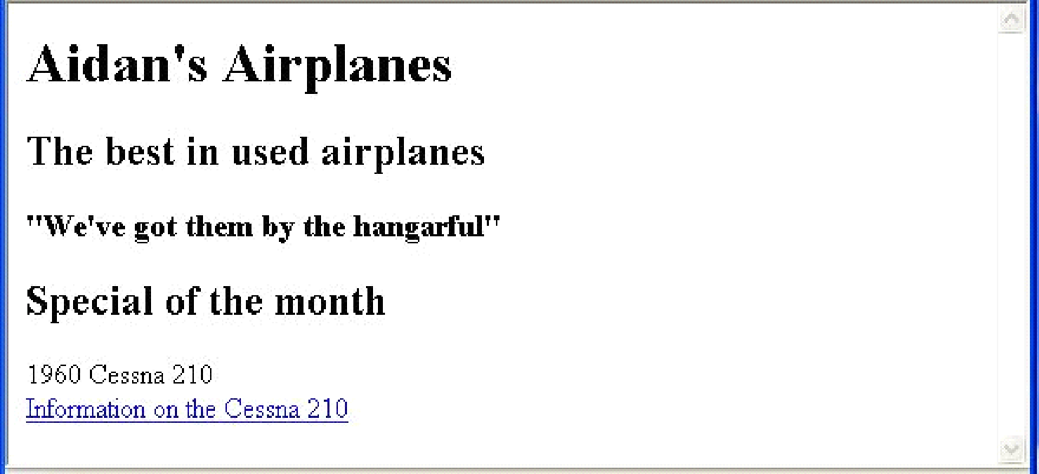
HTML – Basic Markups
Hypertext links…(cntd.)
Example:
<html>
<head> <title> Links </title> </head>
<body>
…
<h2> Special of the month </h2>
<p> 1960 Cessna 210 <br />
<a href = "C210data.html"> Information on the Cessna 210 </a>
</p>
</body>
</html>

Slide 19
HTML – Basic Markups
Lists
Used to present list of information in well formed and semantic way.
HTML supports three primary list types.
Unordered list
Ordered list
Definition List
Ordered lists and unordered lists are the primary list types. By default, ordered lists use numeric identifiers, and unordered lists use bullets.

Slide 20
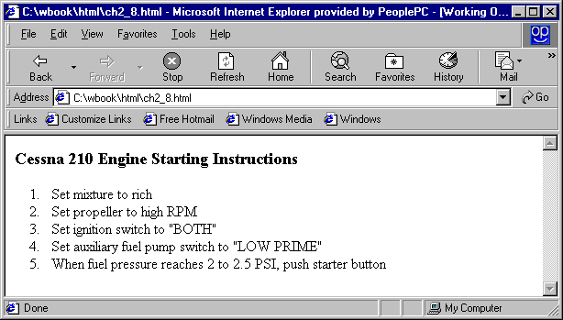
HTML – Basic Markups
Ordered Lists
The list is the content of the <ol> tag
Each item in the display is preceded by a sequence value
<h3> Cessna 210 Engine Starting Instructions</h3>
<ol>
<li> Set mixture to rich </li>
<li> Set propeller to high RPM </li>
<li> Set ignition switch to "BOTH" </li>
<li> Set auxiliary fuel pump switch to
"LOW PRIME" </li>
<li> When fuel pressure reaches 2 to 2.5
PSI, push starter button </li>
</ol>

Slide 21
HTML – Basic Markups
Nested Lists
Lists can be nested inside each other
Eg: <ul>
<li>English
<ol>
<li>One
<li>Two
<li>Three
</ol>
</li>
<li>French
<ol>
<li>un
<li>duex
<li>trois
</ol>
</li>
</ul>

Slide 22
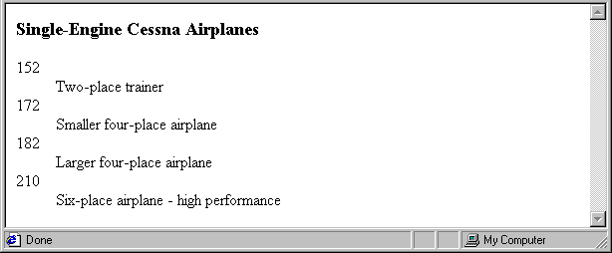
HTML – Basic Markups
Definition Lists
The definition list is used for name / value pairs.
The Definition List is the content of the <dl> tag
Terms being defined are the content of the <dt> tag and is used as the list marker
The definition data are the contents of the <dd> tag
<h3> Single-Engine Cessna Airplanes </h3>
<dl >
<dt> 152 </dt>
<dd> Two-place trainer </dd>
<dt> 172 </dt>
<dd> Smaller four-place airplane </dd>
</dl>

Slide 23
HTML – Basic Markups
Tables
A matrix of cells, each possibly having content
The cells can include almost any element
Some cells have row or column labels and some have data
A table is specified as the content of a <table> tag
A border attribute in the <table> tag specifies a border between the cells
Tables are given titles with the <caption> tag, which can immediately follow <table>

Slide 24
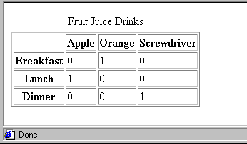
HTML – Basic Markups
Tables…(cntd.)
A table mainly consists of a series of table rows (tr.)
Each table row consists of a number of table data (td) elements.
The table heading (th) element can be used to indicate a table cell should be marked as a heading.
The rowspan and colspan attributes can be used to make a cell span more than one row or column.
Each row of a table should have the same number of columns, and each column should have the same number of rows. Use of the span attribute may require adjustment to other rows or columns.
<table border = "border">
<caption> Fruit Juice Drinks </caption>
<tr>
<th> </th>
<th> Apple </th>
<th> Orange </th>
<th> Screwdriver </th>
</tr>
<tr>
<th> Breakfast </th>
<td> 0 </td>
<td> 1 </td>
<td> 0 </td>
</tr>
</table>

Slide 25
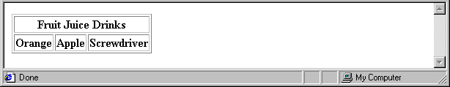
HTML – Basic Markups
Tables : Column Span
<tr>
<th colspan = "3"> Fruit Juice Drinks </th>
</tr>
<tr>
<th> Orange </th>
<th> Apple </th>
<th> Screwdriver </th>
</tr>

Slide 26
HTML – Basic Markups
Tables : Row Span
If the rows have labels and there is a spanning column label, the upper left corner must be made larger, using rowspan
<table border = "border">
<tr>
<td rowspan = "2"> </td>
<th colspan = "3"> Fruit Juice Drinks
</th>
</tr>
<tr>
<th> Apple </th>
<th> Orange </th>
</tr>
…
</table>

Slide 27

THANK YOU
Vinay Joshi
Department of Computer Science and Engineering
vinayj@pes.edu
+91 80 2672 6622

